Slide 1

Research Methodology
Results and Discussion
Unit-3
Dr. Arti Arya
Department of Computer Science and Engineering

Slide 2

Research Methodology
Results and Discussion
(UE18CS400SG)
Dr. Arti Arya
Department of Computer Science and Engineering

Slide 3


Research Methodology
Results
The Results section is a summary of the experimental outcome of the study.
• Results should include a concise verbal description of the outcome as well as tables and figures, showing statistical results and experimental error.
• Tables and figures should include legends explaining what they are summarizing.

Slide 4

Research Methodology
Results
Results should answer main hypothesis or research question(s).
Order of presenting results is arbitrary.
When presenting the results for the main hypotheses, make sure it :
Is clear, concise, simple
Provides enough detail the reader to determine whether the effect of the experimental treatment (vs. chance alone, not bias or sloppy technique) produced the significant statistical value?
Were adverse effects reported?

Slide 5
Research Methodology
Components of a Result Section
Do not state any differences were present between groups unless a significant P value is attached.
State "Cardiac output was less in the beans-and-franks group (P = .03). See Table 2." NOT "There was a significance between the beans-and-franks (B&F) group and the corn dog group. See Table 2."
You may note trends if you like (.05 < P <.10).
Don't comment on results.
Don't attach equal importance (or even bother to include) the entire statistical output. You select those descriptive and inferential statistics you wish to use, and place them in the order that seems reasonable to you.

Slide 6

Research Methodology
Results
It describes what is found in your research work, without discussion, interpretation or reference to the literature.
Just the facts are presented in the form of tables, figures, interview summaries and/or descriptions of what you found that is important and noteworthy.
It must be a simple, clear and complete account of the results of your research.

Slide 7


Research Methodology
A common error in Result Section
Authors generally get confused about the information in the Result and Discussion sections.
Overall, there are two basic ways of organizing the Results:
Presenting all the results in one section, followed by the discussion (perhaps in a different section or paragraph)
Presenting the results and discussion in parts

Slide 8


Results and Discussion
Results = Data Presentation (Experiments showed that…)
Discussion = Data Interpretation (Experiments suggest that…)

Slide 9

Research Methodology
Language Style in Result Section
The Results section is written in a concise and objective fashion.
Irrespective of the field of study, some commonalities are as follows:
Use passive voice, though active voice can be used when required
Use the past tense
Avoid repetitive paragraph structures
Do not interpret data here

Slide 10


Research Methodology
Discussion
Supposed to be the heart of the Paper.
Purpose: To state the
Interpretations ;
Opinions;
Explain the implications of your findings
Make suggestions for future research.
Role:
To answer questions posed in the Introduction,
Explain how the results support the answers and
How the answers fit in with existing knowledge on the topic.

Slide 11

Research Methodology
Discussion
The Discussion section is where the results are interpreted and conclusions are drawn.
The Discussion should also compare the results to those of other studies and give the general significance of the findings.
Study limitations, sources of error, and plans future work are usually presented in the discussion

Slide 12

Research Methodology
Discussion
Not mere details about the results;
interpret and explain the results.
(Un)expected results
Reference to previous research
Explanation
Exemplification
Deduction and hypothesis
Recommendation
Provide
a commentary and not a reiteration of the results

Slide 13
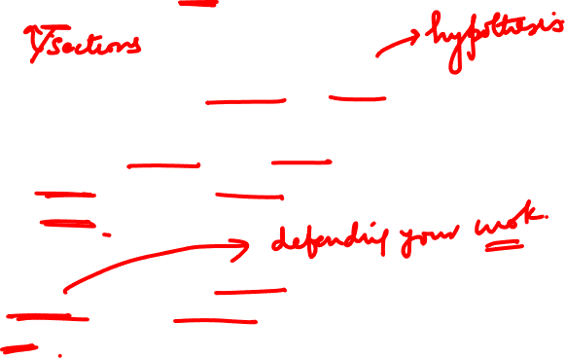
Research Methodology
Discussion
Begin by briefly summarizing the previous chapters, then discuss what you found.
Provide meaningful answers to the question
Interpret objectively and subjectively and to make references to what others have said on the subject.
Make sure that every conclusion you draw is defensible and not just your own personal opinion.

Slide 14

Research Methodology
Discussion: Interpretation and Findings
• It addresses the meaning of your findings.
• In some cases, when your results are in the direction you predicted, this meaning was anticipated when the study was designed.
• In cases where the results are not all in the desired direction, researchers must explain why this was not the case.
[Address sampling, measurement, and procedural issues as well as confounding variables ]

Slide 15
Research Methodology
10 Tips for Discussion
1.
Organize the Discussion from the
specific to the general:
your findings to the literature, to theory, to practice

Slide 16

Research Methodology
Discussion
2.
Begin by re-stating the hypothesis you were testing and answering the questions posed in the introduction

Slide 17

Research Methodology
Discussion
3.
Explain how your results relate to expectations
Clearly state why they are acceptable and
How they are consistent or fit with published knowledge

Slide 18

Research Methodology
Discussion
4.
Address all the results regardless of whether or not the findings were statistically significant.
5.
Describe the patterns, principles, and relationships shown by each major finding/result and put them in perspective.
The sequencing:
First - state the answer,
Second - support with relevant results,
Third - cite the work of others.

Slide 19

Research Methodology
Discussion
6.
Defend your answers by explaining both why your answer is satisfactory and why others are not.
Only by giving both sides to the argument can you make your explanation convincing.
Notes:
19

Slide 20

Research Methodology
Discussion
7.
Discuss and evaluate conflicting explanations of the results.
This is the sign of a good discussion.
Notes:
20

Slide 21

Research Methodology
Discussion
8.
Discuss any unexpected findings.
When discussing an unexpected finding, begin the
paragraph with the finding and then describe it.
Notes:
21

Slide 22

Research Methodology
Discussion
9.
Identify potential limitations and weaknesses and comment on the relative importance of these to your interpretation of the results and how they may affect the validity of the findings.
When identifying limitations and weaknesses, avoid using an apologetic tone.
Notes:
22

Slide 23

Research Methodology
Discussion
10.
Summarize concisely (brief, and specific)
Explain implication and importance
Provide recommendations (not >2) for further research.
Notes:
23

Slide 24

Research Methodology
Discussion
https://www.youtube.com/watch?v=LfCGoWtF_tc
Notes:
24

Slide 25

Research Methodology
Discussion
Don’t
Simply rehash your results.
Exaggerate.
End with it.
Do’s
Provide context and explain why people should care.
Emphasize the positive.
Look toward the future

Slide 26

Research Methodology
Acknowledgement
It is important to acknowledge all contributors to the study, including your research mentor, your mentor’s research associates, computer consultants, and funding sources.
You should also acknowledge any businesses, organizations or institutions that donated equipment or material for use in the study
http://www.tulane.edu/~lamp/pdfs/Presenting_Research_Results.pdf

Slide 27

Research Methodology
Oral Presentation
The format for an oral scientific presentation is essentially the same as that of a scientific paper.
The presentation should include the following sections: introduction, methods, results, discussion, and acknowledgments
http://www.tulane.edu/~lamp/pdfs/Presenting_Research_Results.pdf

Slide 28

Research Methodology
Poster Presentation
A poster presentation contains the same basic information as an oral presentation, but the information is arranged on a large sheet of paper (generally 4’ x 3’).
The information is presented in blocks of text (be concise) and figures.
Arrange blocks in columns from upper left, down to lower right, concluding with acknowledgements
http://www.tulane.edu/~lamp/pdfs/Presenting_Research_Results.pdf

Slide 29

Research Methodology
Poster Presentation
Look professional.
It is important to address your audience when speaking.
If necessary, use note cards or text on slides to (talking points) organize your presentation.
Rehearse your presentation in front of your mentor or his/her research associates.
Leave at least 3 minutes for questions.
http://www.tulane.edu/~lamp/pdfs/Presenting_Research_Results.pdf

Slide 30
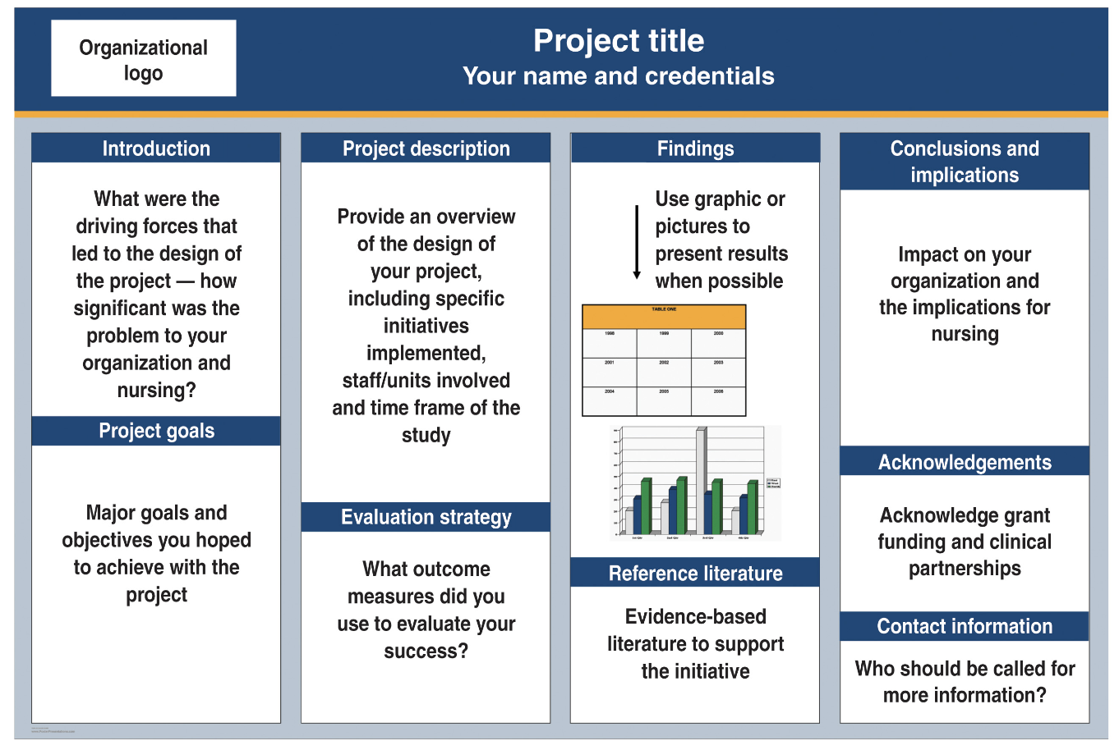

Research Methodology
Poster Presentation
https://www.myamericannurse.com/how-to-create-an-effective-poster-presentation/

Slide 31
Research Methodology
Poster Presentation
Stand in front of poster and greet onlookers: “Hello. My name is…I am a student from …Would you like to hear about my research?”
Try to explain information in your own words without reading (you know what you did).
Give background, hypothesis and important results and conclusions.
Explain images and graphics.
“I would be happy to answer any questions you might have.”
http://www.tulane.edu/~lamp/pdfs/Presenting_Research_Results.pdf

